Slide 1

SOUTHERN UNIVERSITY AND A&M COLLEGE
COLLEGE OF BUSINESS 1937-2018
B&I Cluster Spring 2018
DONALD R. ANDREWS, PH.D., DEAN

Slide 2
The Five Cs of Innovation Change, Challenges, Choices, Creation, and Completion
Change
The New Economy
As Outline in The Second Machine Age by Erik Brynjolfsson and Andew McAfee 2014

Slide 3
The New Economy
Change
“When the rate of change outside the organization is faster than the rate of change inside the organization, then the end is near.” Jack Welch, Retired CEO, GE

Slide 4
How to Solve the Economic Problem Hunter Gatherer Age

Slide 5



Accelerating Pace of Change
Knowledge
Age
Industrial
Age
Agricultural
Age
1100
1300
1500
1700
1880
1900
1920
1940
1960
1970
1980
1990
2000
SOURCE: M. Emmi, SCT Corporation
Notes:
Agricultural Age
Lasted thousands of years
Significant change happened over centuries
Competitive advantage was based on land
Industrial Age
Lasted approximately 100 years
Significant change measured in decades
Competitive advantage based on raw materials and
mass labor
Knowledge Age
Today
Rate of change = years or even months (accelerating)
Sources of competitive advantage are shifting --
less tangible
Technology plays a key role
Creative Age
Slide 3

Slide 6



From Knowledge Economy to Creative Economy
DESIGN CREATE IMPLEMENT

Slide 7

Brilliant Machines (Deep Blue and Mr. Watson) Can I Help You Think?
As Outline in The Second Machine Age by Erik Brynjolfsson and Andew McAfee 2014

Slide 8
Challenges
The Transformation

Slide 9
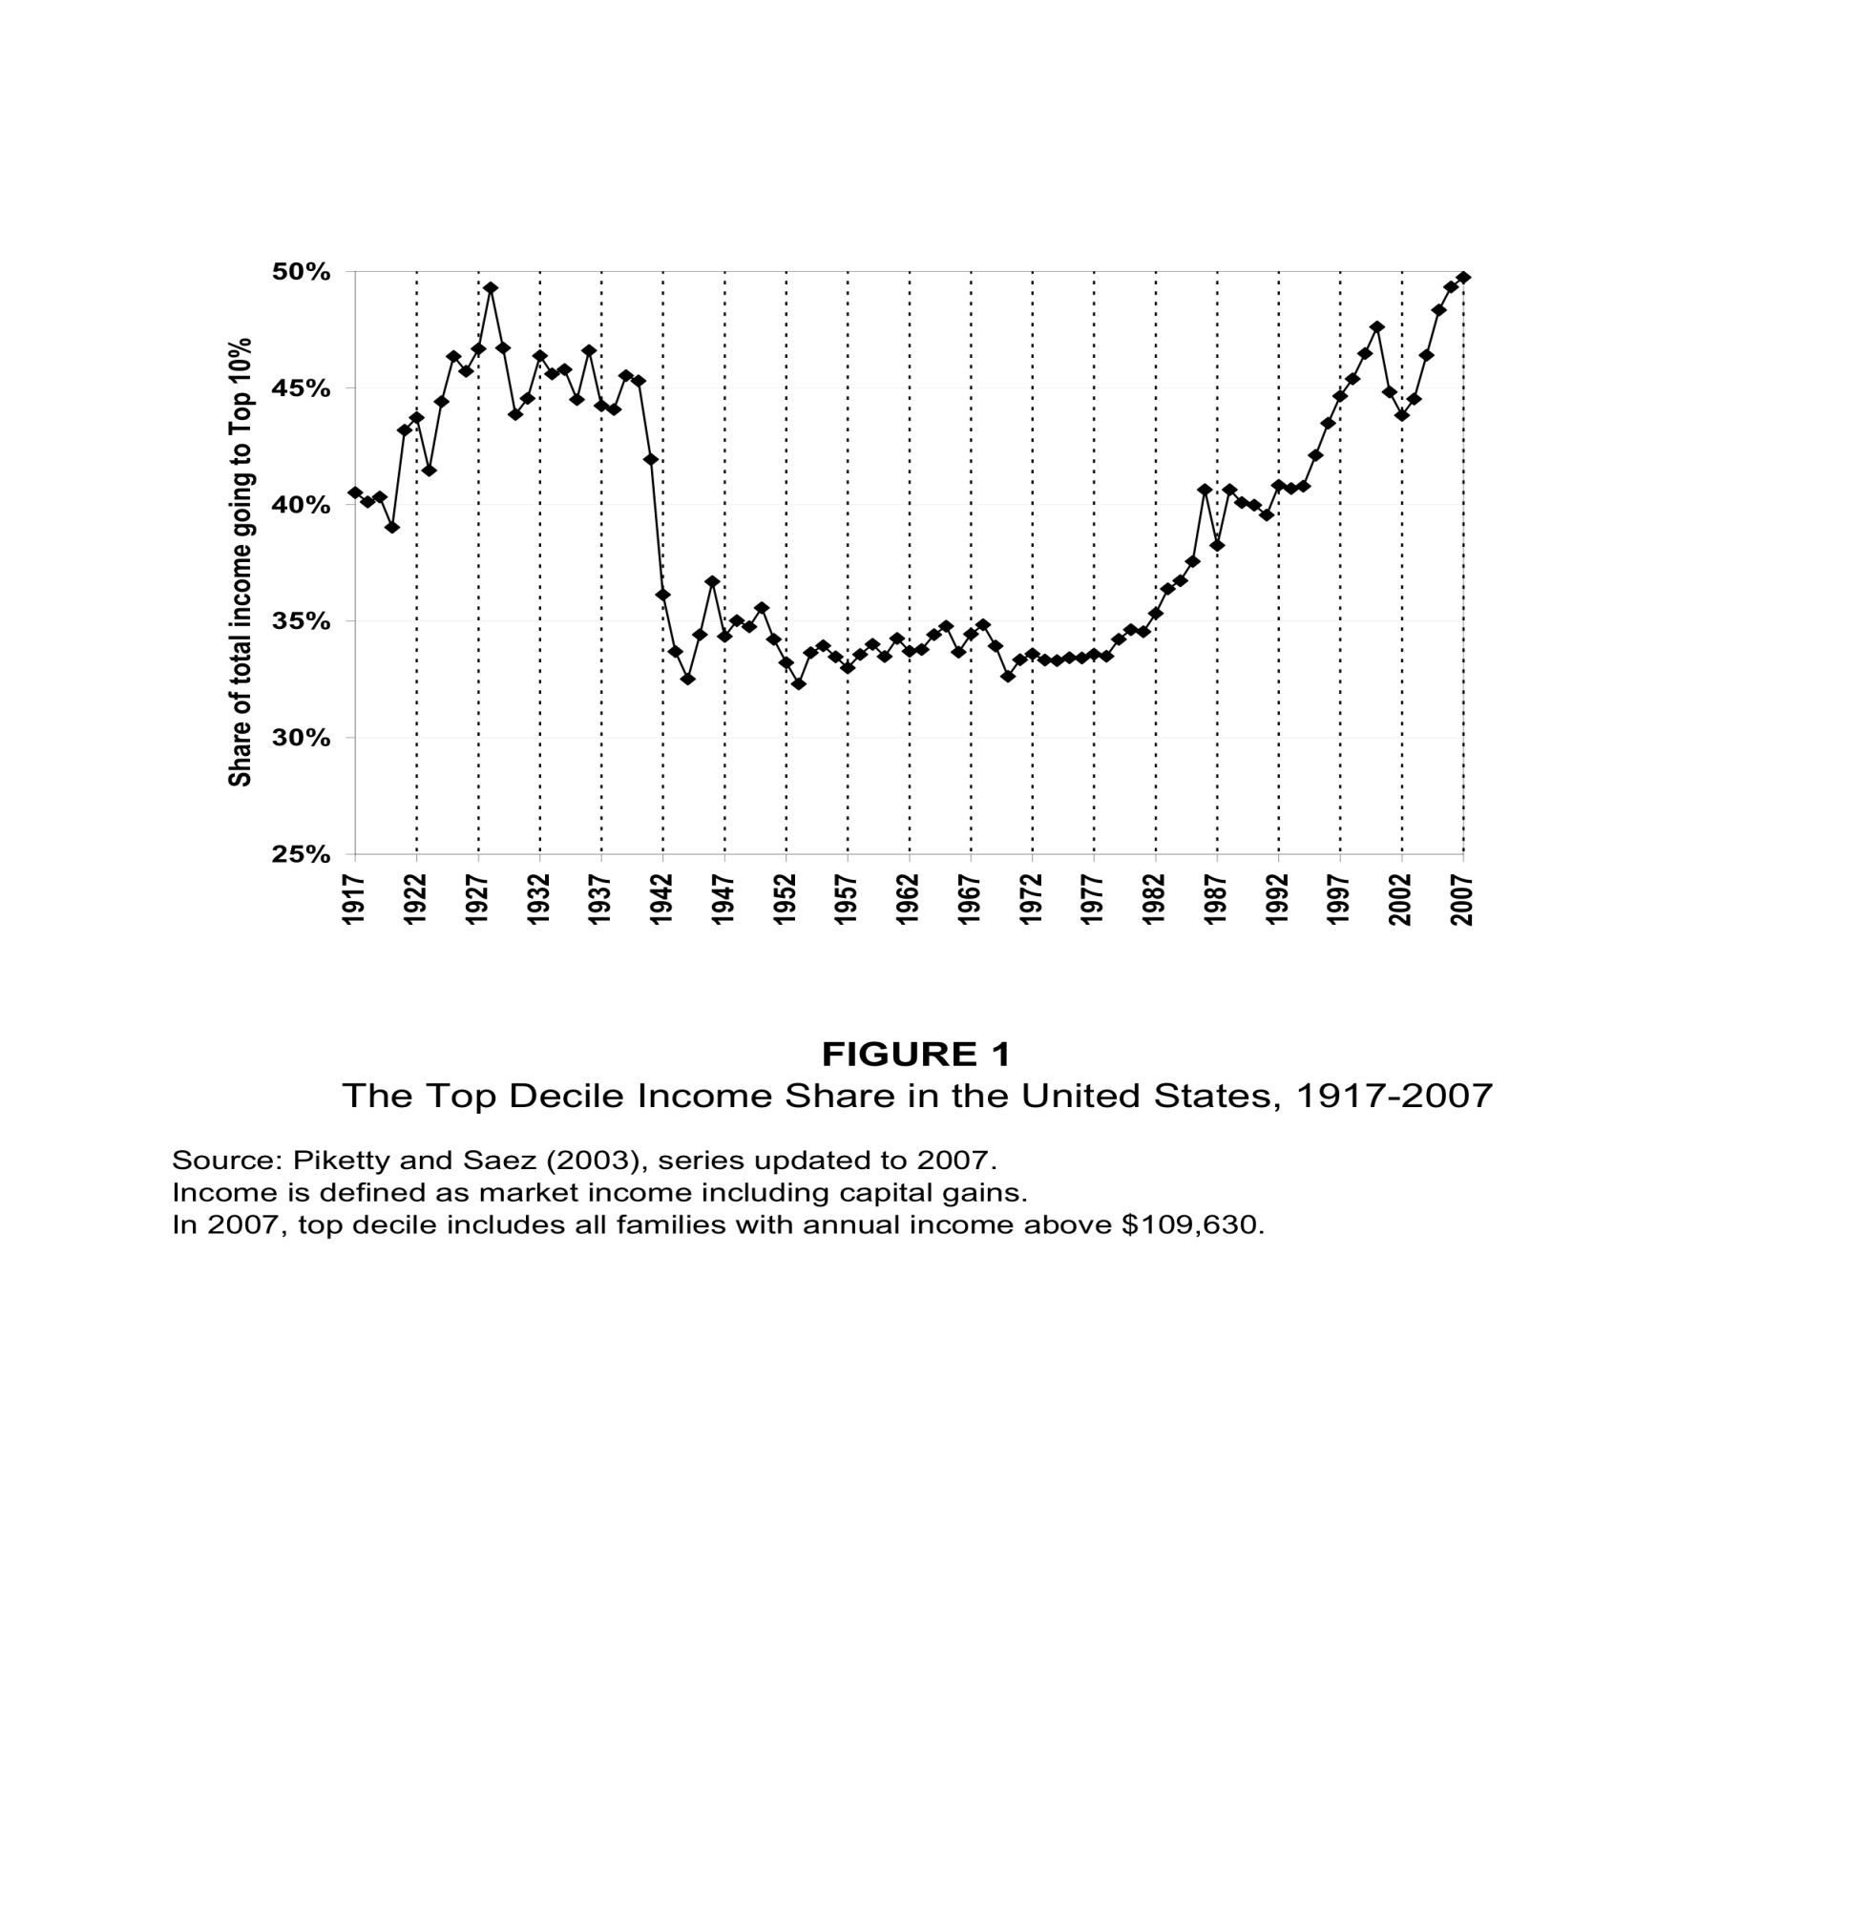
Income Share to Top 10 Percent 1917-2007

Slide 10
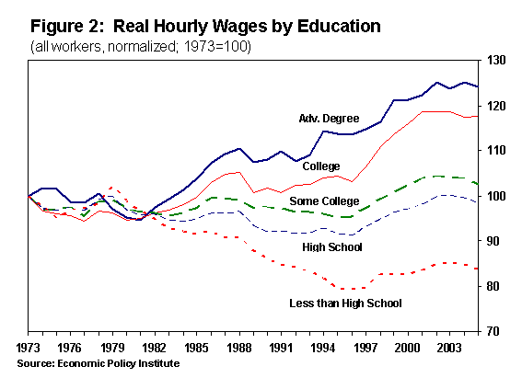
Growth in Wages by Education
1973-2005

Slide 11
CHOICES
The Leadership

Slide 12
Vision
The Best Way to Predict the Future is to Create It

Slide 13
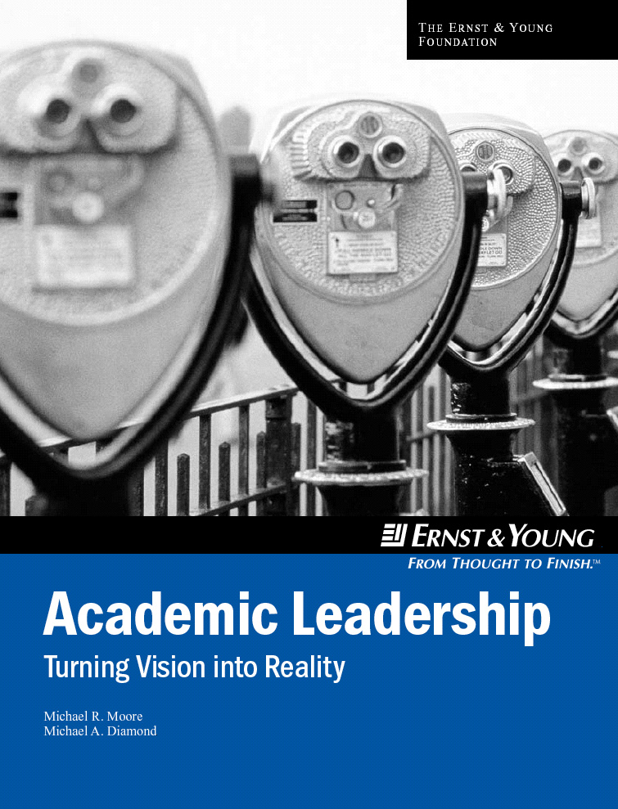
For a .pdf download:
michael.moore1@home.com
For a hard copy:
ellen.glazerman@ey.com
Notes:
Thank you for the opportunity to talk about what we think we have learned about academic leadership, as a result our work in facilitating strategic planning at more than thirty business schools. My comments are in the context of helping our partnership schools to make strategic choices to distinguish their programs and scholarship in a world of changing expectations, intense competition and and fast-moving technology.
My colleague in this venture is Michael Diamond, Vice-President and Executive Vice-Provost of the University of Southern California. We have written about our experiences in a book published by the Ernst & Young Foundation. If you are interested in more specifics, I’ve provided references to where you can get a hard copy or PDF copy of the book.
Our work is not focused, per se, on undergraduate curricula, but the strategic choices, made by our partnership schools, largely determine the context within which their undergraduate curricula are designed. So, although my comments on leadership are in the context of this more general experience, my sense is that the character and quality of leadership needed to forge agreement on strategic choices, and to enroll support for implementing these choices, would be very much applicable to the challenges of curriculum design and improvement.

Slide 14
Leadership
Leadership is the capacity to release
and engage human potential in the
pursuit of common cause.
… Michael Moore and Michael Diamond
Academic Leadership: Turning Vision into Reality
Notes:
Leadership is purposeful. It has a vision, a focus. The leader does not have to create the vision but, there must be one, and it must be shared by others.
Leadership enables people to act, to pursue their interests and to grow. Leaders don’t install interests or motivation, but they do support people in their growth.
Leadership is not high individual performance, although leaders are often high performance people. Leadership happens only among people in relationships.
A leader’s effectiveness is always a function of the performance of the followers – who actually empower the leader by joining in common cause. We know that people do have negative power – by withholding power from leaders, usually not openly and defiantly, but simply by inattention – by just keeping busy with other defensible priorities.
James MacGregor Burns said that leaders show an abilitiy to learn from others, the capacity to be taught, to listen and to be guided without being threatened – the ability to lead by being led! Max DePree described this mutuality as a covenant, in which leaders take risks in relationships that require “us to be abandoned to the talents and skills of others and, therefore, to be vulnerable.”

Slide 15
Leadership Challenges
• Individual vs. Institutional Focus
• Isolation vs. Integration
• Decision Gridlock vs. Speed-to-Market
• Structural Forces – A Stable System
• Academic Cultural Values
Notes:
Leadership is a human quality, not an institutional one. But institutions greatly influence the nature, quality and extent to which human leadership can flourish. I’ve always been intrigued by the tensions between high performance people (including faculty members, by the way!) and their institutions. Too often, I think, institutions prevail in these tensions, and thereby deny themselves the talents and commitments of the very people who are essential to organizational renewal. The high performers withdraw their talents, even if they stay. (People do drop out without leaving!) They maintain the institution without contributing to its growth, and they apply their creative energies in other, more receptive aspects of their lives.
Academic units face even greater challenges than do business organizations in shifting from an individual to an institutional focus. Academic freedom and the traditional protection of individual preferences in research, teaching and service may be seen as threatened by (1) growing emphasis on the academic unit’s priorities, (2) the imperative of becoming market-driven, (3) the expectation of greater integration across the disciplines, and (4) the expectation of greater efficiency in learning.
There are special leadership challenges within the academic culture.

Slide 16
Planning Success Principles
• Leadership
• Attention to the Marketplace
• Engagement of Stakeholders
• A Structured Framework
• Facilitated Teamwork
Notes:
Our experience suggest five success principles in strategic planning processes.
Again,weI think that leadership is the most important of the success principles and, in our experience, leadership is the greatest variable from school to school.
James Collins, author of Built to Last, has written a new book, Good to Great, in which he focuses on leadership. Collins suggests that leaders forget about charisma, going so far as to suggest that having charisma is something akin to having a speech impediment!
Collins highest performing leader (Level 5) is described as “a selfless individual who attracts like minded folks and gets them to work thoughtfully toward a set objective.”
Mike Diamond and I have suggested a simple working definition of leadership that is quite similar to Collins’ description.

Slide 17
Strategic Framework
Distinctive
Capabilities
Measures
of Success
Mission
Strategies
Shared Purpose
Shared purpose
provides focus
by driving strategy.
People
Scholarship
Shared Values
Shared values
provide control
by guiding execution.
Education
Programs
External
Relations
Measures
of Success
Indicators of mission
achievement.
Internal
Operations
Notes:
The three left-most columns of the framework are what we call the “direction-giving” elements of the plan, while the single right-most column identifies the pathways for implementation – strategies and related actions.
• Mission: Shared Purpose and Shared Values
• Distinctive Capabilities: Add special value to a targeted market segment.
• Measures of Success: Define intended results in operational specifics.
The roots of successful strategic planning, we believe, lie in the often difficult choices made within the direction giving elements. The emphasis is on getting agreement around the strategic direction so that that school’s programs and resources will be more focused.
No school, no matter how richly endowed, can afford the luxury of being unfocused.

Slide 18
Professional Responsibilities
What Makes a Great Enterprise According to Jim Collins
  1. Superior Results
  2. Distinctive Impact ( Would Anyone Miss Us)
  3. Lasting Endurance (Can it be Great without you)
For an Educational Enterprise
  1. Superior Instruction
  2. Distinctive Research
  3. Lasting Service to Stakeholders

Slide 19
Creation
Development of Opportunities

Slide 20
The Timmons’ Model of the Entrepreneurial Process
The
Resources
Communication
The
Opportunity
Business
Plan
Creativity
The
Team
Leadership

Slide 21
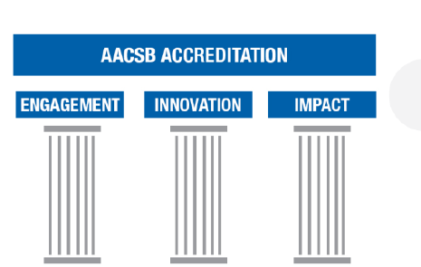
Business School Accreditation
AACSB Accreditation

Slide 22
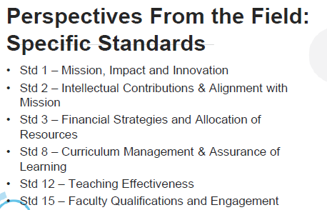
AACSB 2013 Major Standards

Slide 23
Professional Development
Driven by Accreditation Standards
  Strategic Management and Innovation
    Mission and Financial Strategies
  Participants – Students, Faculty, and Professional Staff
    Student Support- Advising, Career Services
    Recruitment, Hiring, Mentoring, Evaluation and Reward
  Learning and Teaching
    Curriculum Management and Development
    Learning Goals and Assessment
    How High Quality Teaching is Supported and Developed
  Academic and Professional Engagement
    Student Academic Engagement
    Strategies Supporting Faculty Engagement

Slide 24
Academic Innovation
Opportunity for Learning Enhancement
Team in the Development Process
Resources for Implementation
Connect the Dots
  Show Creativity
  Must Communicate
  Leadership

Slide 25
Student Achievement
Industry Connections
Speakers and Field Trips
Student Leadership Development
Student and Faculty Internships
Curriculum Feedback and Change
Study Abroad
Career Placement
Homecoming Friday (Alumni Return)

Slide 26
Areas of Support to the College of Business
Serving in COB Advisory Council/Board.
Helping in exploring and facilitating Internship opportunities.
Assisting Placement of COB Graduates.
Participating in the MBA Global Leadership Speaker Series.
Coaching students and Judging Case competitions.
Conducting Soft skill workshops (interviewing and resume writing skills etc.)
Sharing life lessons and personal experiences to COB students through class room visits.
Participating in and assisting in the promotion of the Gala on the Bluff.
Participating in the COB Strategic Plan retreats.
Assisting in student recruitment efforts.
Attending COB sponsored special meetings, panel discussions, conferences and other events.
Promoting the COB undergraduate and graduate programs.
Sharing experience in COB curriculum review and development processes

Slide 27
Proposed New Academic Programs
Graduate Certificate in Supply Chain Management
Online MBA
Entrepreneurship Across the Campus
Business Analytics
Human Resources Management
Accounting Information Systems (ERP/SAP)
Finance/Insurance Concentration

Slide 28
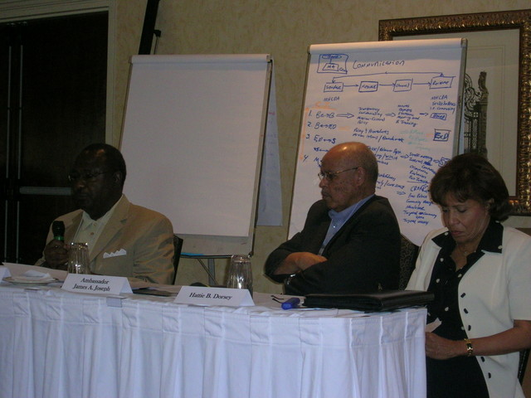
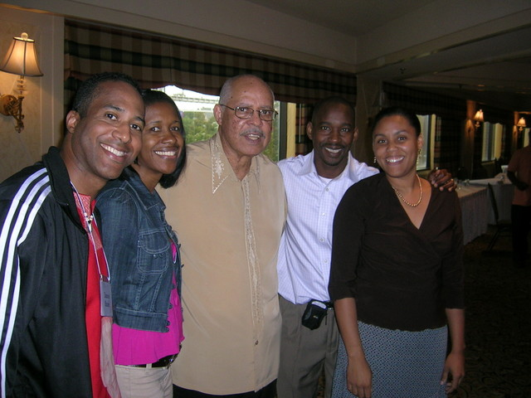
Louisiana Effective Leadership Program
Purpose: To identify emerging leaders and teach them how to be servant leaders.
Duke and SU
Ambassador James A. Joseph
Funding:
  Ford
  Kellogg
  Louisiana Disaster Recovery Foundation

Slide 29
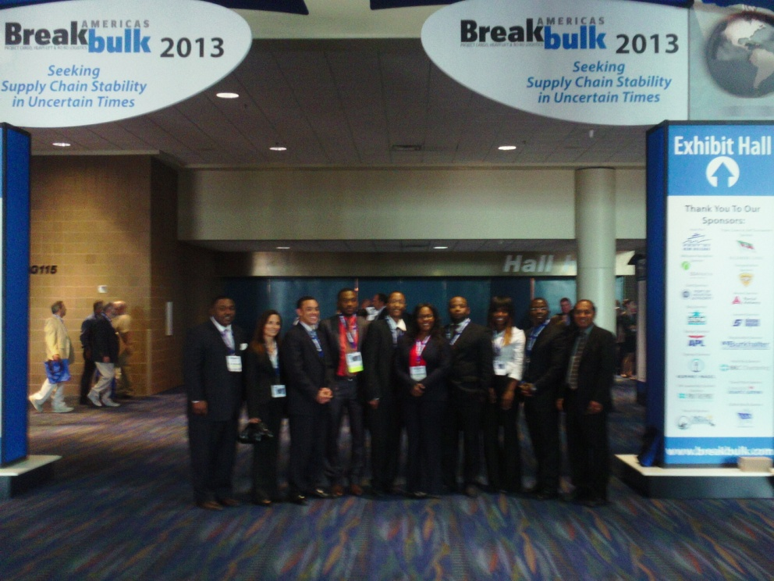
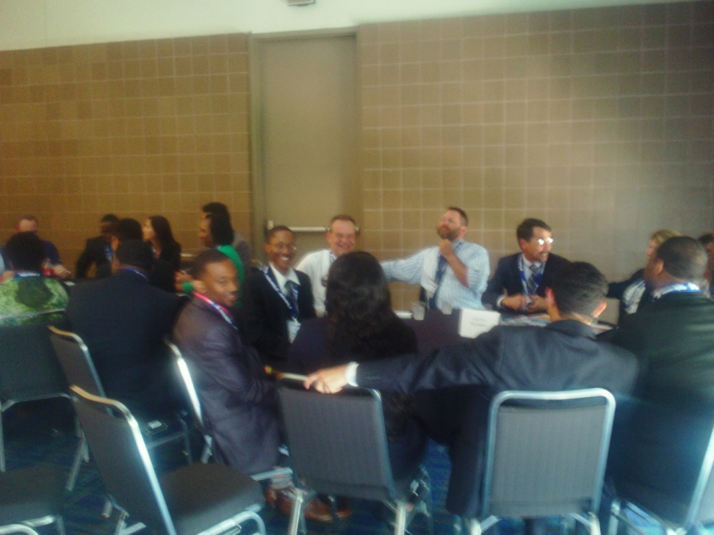
Industry Conferences
Breakbulk Americas Conference
New Orleans
What information, activity, or other aspect(s) of the Conference was most useful to you? Why?
“Learning about cargo ships and how they operate. The bulk of security clearance that Manchester Terminal had to go through was really interesting. The roundtable discussion was very useful too because of the advice the company representatives gave to the students from various colleges such as SU and Texas Southern.”

Slide 30

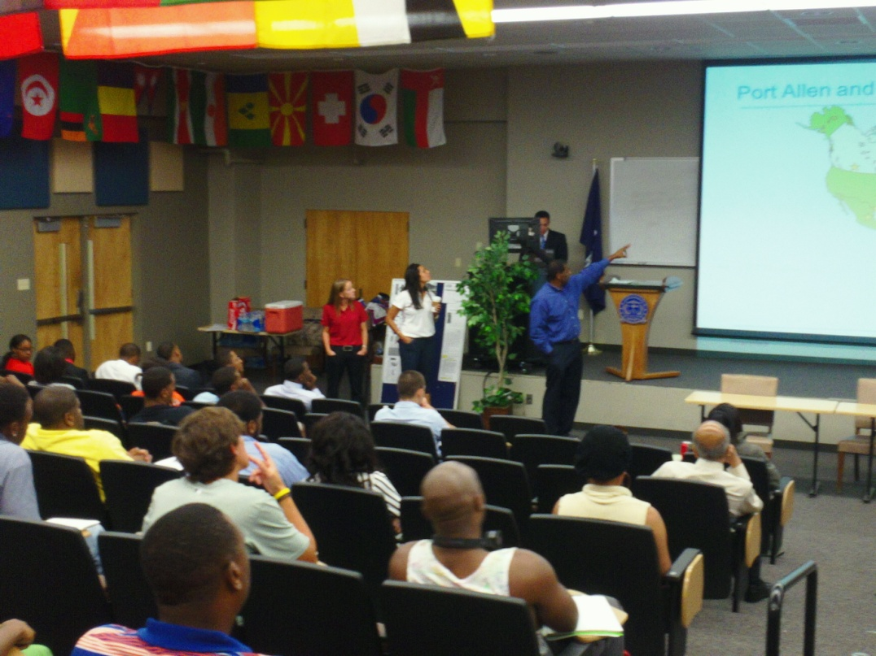
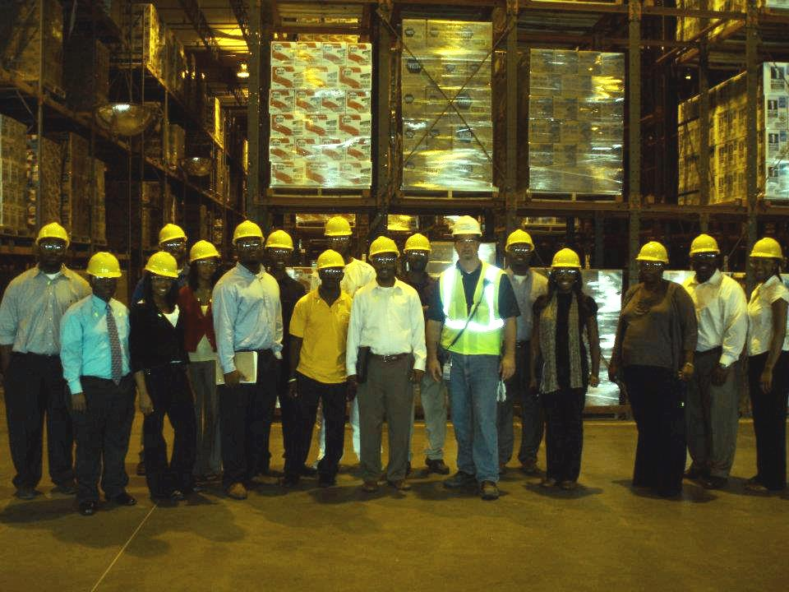
Speakers and Field Trips

Slide 31
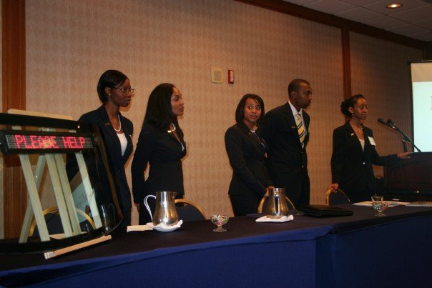
Student Leadership
Thurgood Marshall
OFC Venture Challenge
Hackathon/Business Plan Competitions
Allen Entrepreneurial Institute
Delta Regional Authority HBCU Entrepreneurial Ecosystem
Project Propel SAP Delaware State

Slide 32
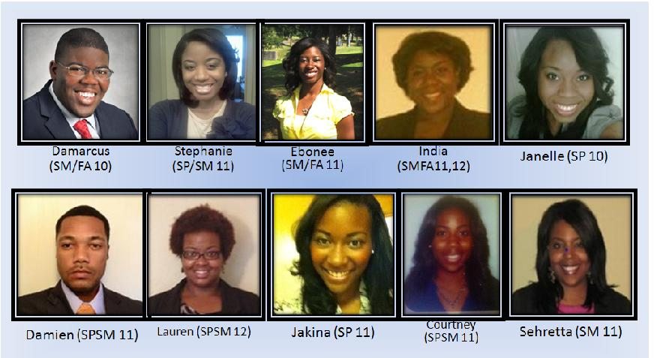
Meet Our Interns/Co-Ops at J&J
Titles/Areas: Supply Chain Planning, Plant Planning, Trade Customization, Third Party Manufacturing Strategic Sourcing, Supply Chain Logistics, Operations Project Management, Procurement and Leadership Development Program.

Slide 33


Slide 34
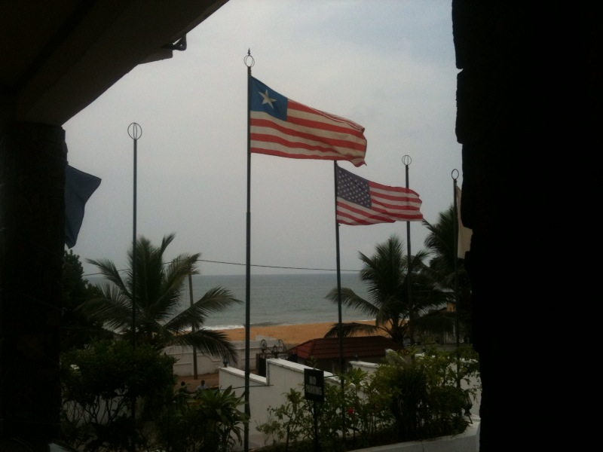
Liberia Opportunities 2010-2011

Slide 35

Opportunities in Brazil for HBCUs
“Science without Borders”

Slide 36
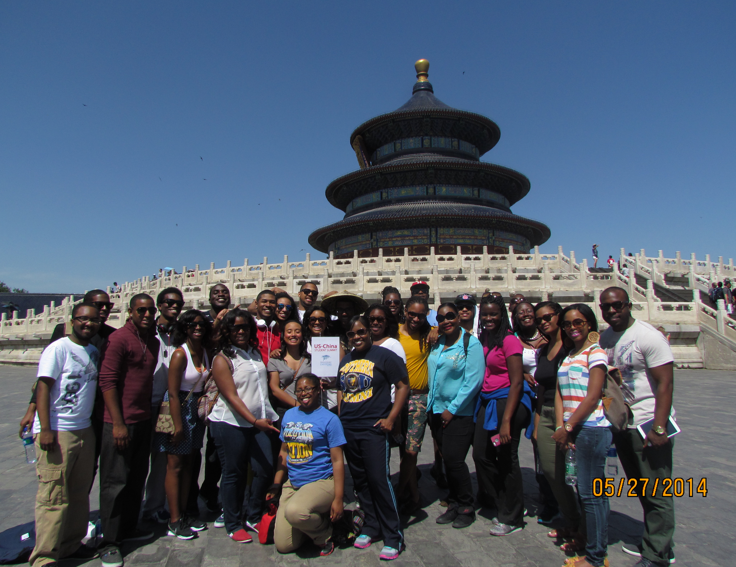
100,000 Strong Initiative
Study Abroad
National effort that emphasizes the importance of the China-U.S. relationship
Movement to bring 100,000 students to study in China
College of Business 2014
Notes:
The U.S.-China Student Summit, operated by WorldStrides with the support of the 100,000 Strong Foundation, aims to fulfill the initiative first set forth by President Barack Obama and the State Department to strengthen our relationship with China through our young people. With the support of the State Department, Peking University, and high-level government and education officials in China, it has become a movement that will quickly outlive even its name! The initial goal of 100,000 students studying in China will likely be reached, and then expanded. Each university participating in the inaugural U.S.-China Student Summit will play a part.

Slide 37
Completion

Slide 38

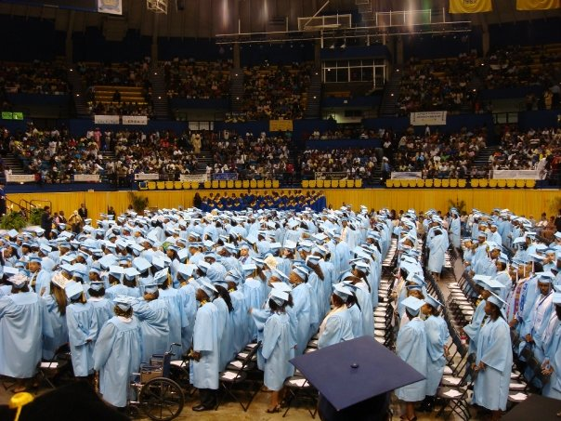
Southern University Spring 2008 Commencement
- Jeff Timmons
“The best way to successfully predict the future is to create it.” - Jeff Timmons

Slide 39
Malcolm Gladwell and his Book
Outliers: The Story of Success
An Example
Champion

Slide 40


Slide 41
Why Geese Fly the V-Formation

Slide 42
Questions and Answers

